Slide 1


Question 1
Introduction to Data
Management and Publication
By Gabe Kamener FCE Information Manager, Florida International University
2026 Florida Coastal Everglades LTER Information Management
January 22, 2026

Slide 2
Overview
Review
Sharing of LTER Network data
EDI data repository and FCE data catalog
Citing data
Best practices
Data and project management
Formatting data
Describing metadata
Preparing for publication with ezEML

Slide 3
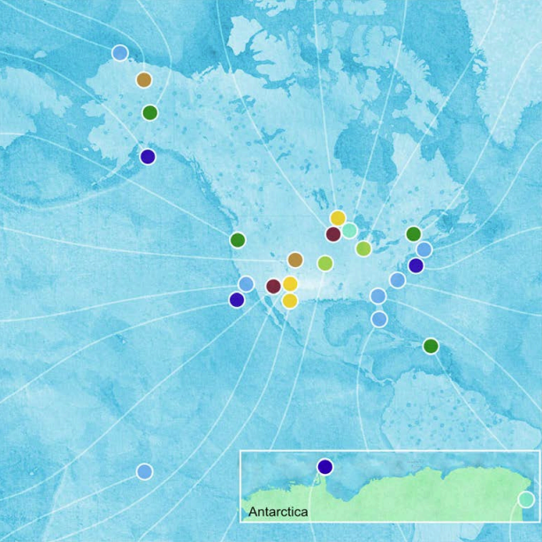
Sharing of LTER Network Data
Ongoing since NSF funded first LTER sites in 1980
Enables new science!
Supports open science and reproducibility
Funders and journal publishers often require datasets in a recognized data repository

Slide 4
LTER Network Data Release Policy
Data and information derived from publicly funded research in the U.S. LTER Network, totally or partially from LTER funds from NSF… [must be].. made available in a community accepted data repository… with as few restrictions as possible, on a nondiscriminatory basis.

Slide 5

Two Types of LTER Data
Type I – data are to be released to the general public according to the terms of the general data use agreement within 2 years from collection and no later than the publication of the main findings from the dataset
Type II - data are to be released to restricted audiences according to terms specified by the owners of the data. Type II data are considered to be exceptional and should be rare in occurrence.

Slide 6
FCE LTER Graduate Student Data
Submit complete dataset and metadata to FCE Information Manager (IM) before graduation
Meet with IM at least 2 months before you need to publish data

Slide 7
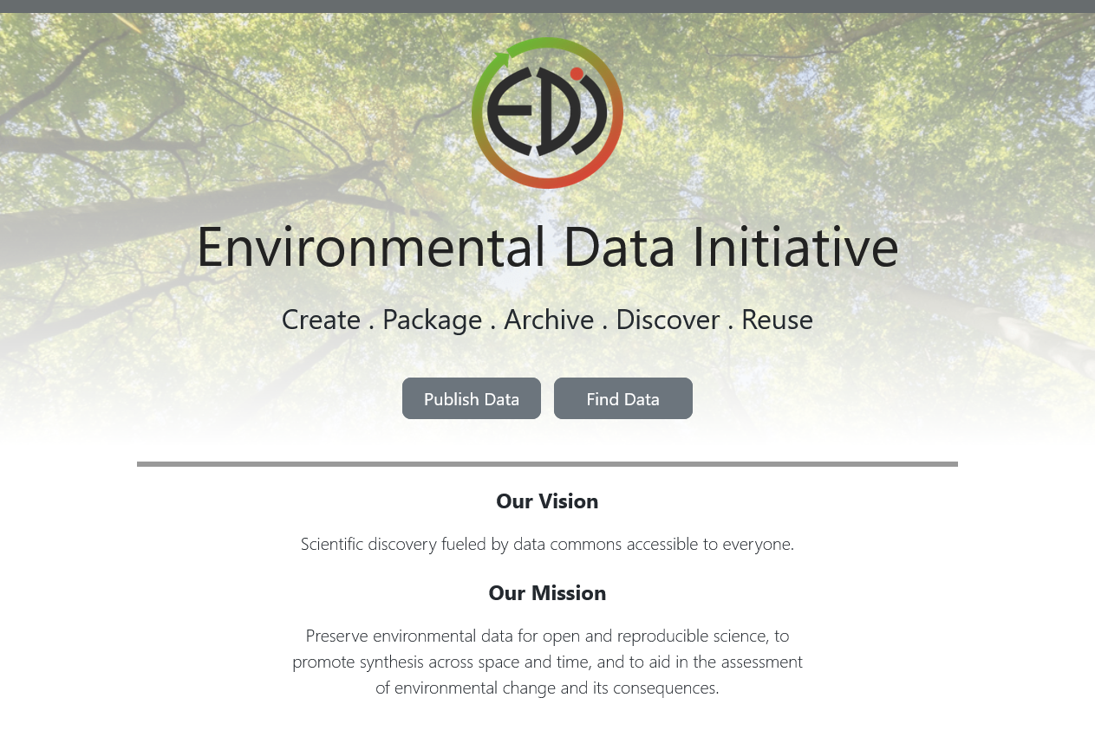
The Environmental Data Initiative (EDI) Data Repository
Funded by NSF
Provides:
Long-term data security
Long-term data accessibility
Data integrity
Data discovery
Citable digital object identifiers (DOIs) for datasets
https://edirepository.org

Slide 8
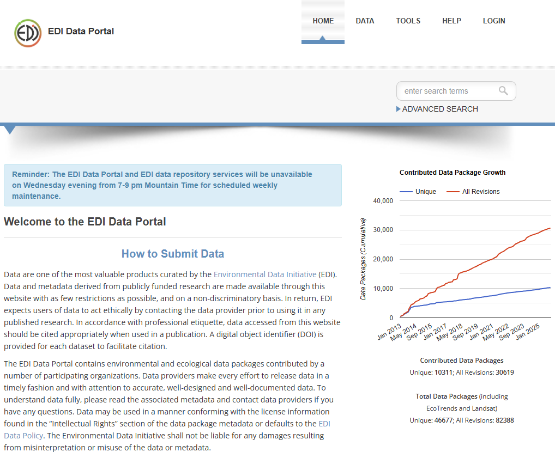
EDI Data Portal
User-friendly interface of EDI repository
More than 10,300 searchable, unique data packages
Advanced search functionality
https://portal.edirepository.org/nis/home.jsp

Slide 9
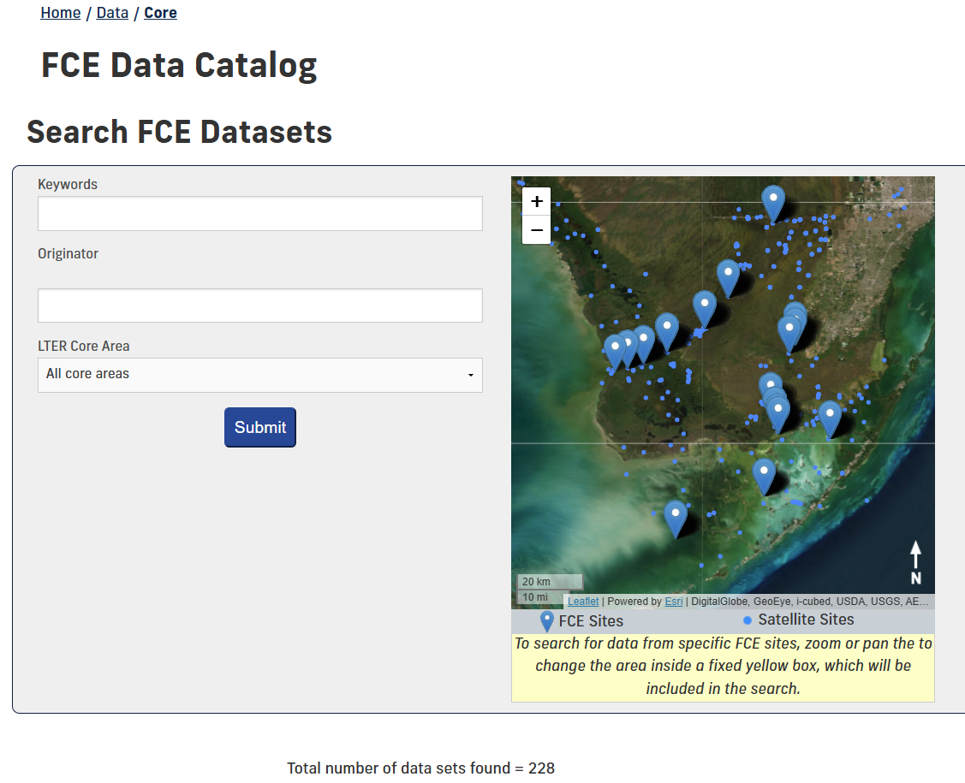
FCE Data Catalog
Lists FCE datasets published in EDI
Easily search the catalog from the FCE website!
https://fce-lter.fiu.edu/data/core/index.php

Slide 10
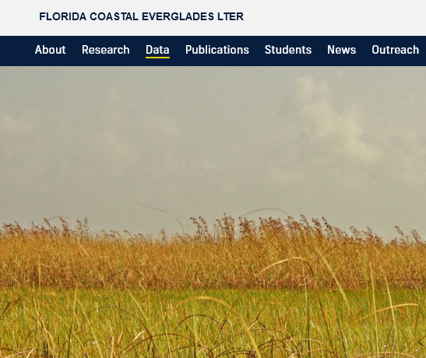
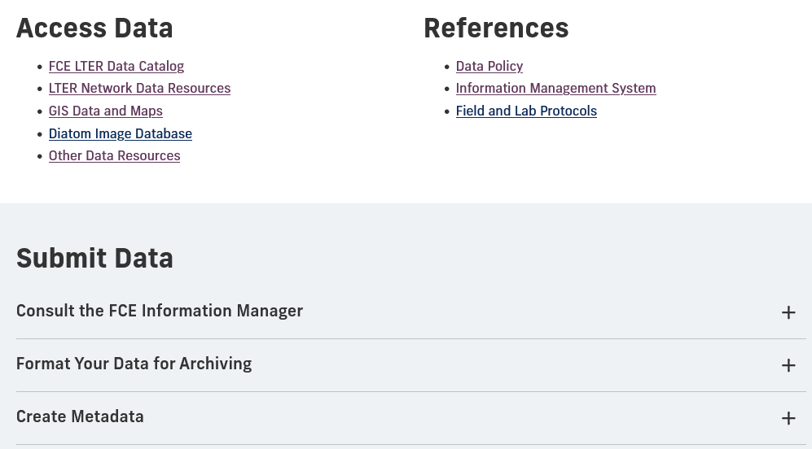
Steps to Publish Data in the EDI Repository
Review the FCE Data page!
Contact the FCE IM about:
Data (tabular, model code, imagery, etc.)
Required metadata
How to format your dataset
Getting an FCE dataset ID
Enter data and metadata into ezEML
Review package with FCE IM and publish!
https://fcelter.fiu.edu/data

Slide 11
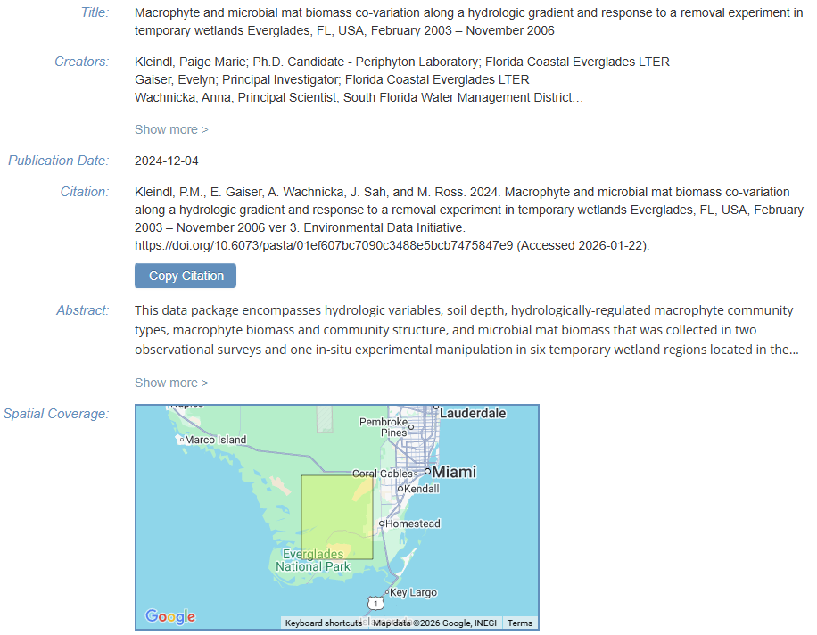
Citing Data
Kleindl, P.M., E. Gaiser, A. Wachnicka, J. Sah, and M. Ross. 2024. Macrophyte and microbial mat biomass co-variation along a hydrologic gradient and response to a removal experiment in temporary wetlands Everglades, FL, USA, February 2003 – November 2006 ver 3. Environmental Data Initiative. https://doi.org/10.6073/pasta/01ef607bc7090c3488e5bcb7475847e9 (Accessed 2026-01-22)

Slide 12
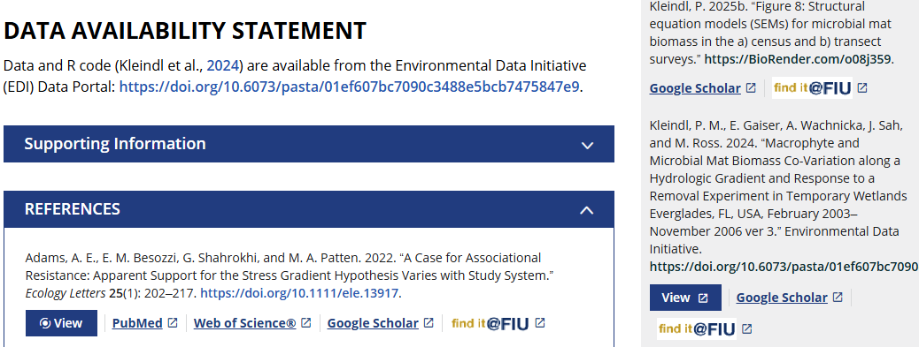
Citing Data
Include full citations (with DOI) in References and then cite those references in Data Availability Statement (also include DOI links there)
https://doi.org/10.1002/ecs2.70384

Slide 13
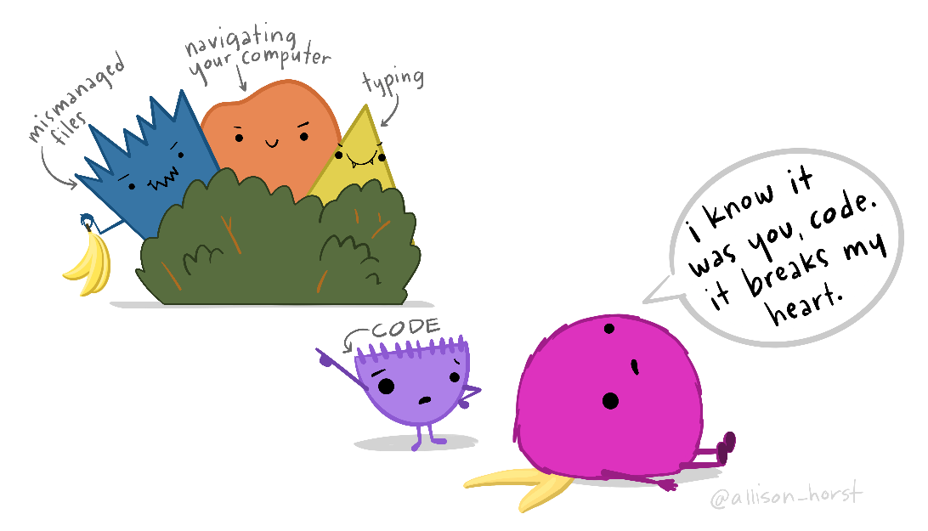
Best Practices in Data Management
“Well managed data is a benefit to any researcher as it requires less digging to find, less effort to understand, and less processing to prepare for collaboration, reuse, and sharing.” -Briney et al. 2020.
Artwork by @allison_horst (CC BY 4.0)

Slide 14
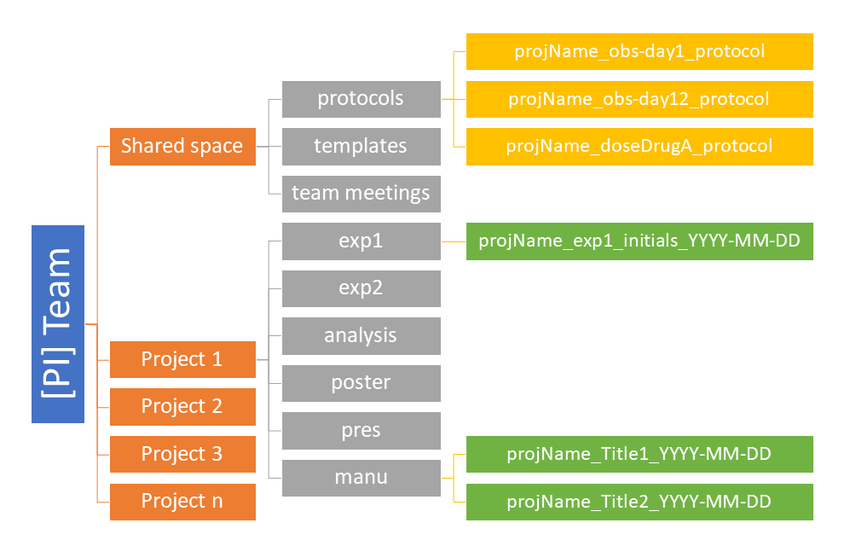
File Organization
Use folder structures
Use consistent file names
Keep raw data separate from analysis
Use file versioning
Briney et al. 2020

Slide 15

Backup Your Data
3-2-1 rule
Three copies of the data
Two geographically separate locations
More than one type of storage device
Artwork by @allison_horst (CC BY 4.0)

Slide 16
Write a Living Data Management Plan
Document important details (e.g. file organization and storage, backup plan, etc.) in one place
Can be relatively short
Update as research project evolves
Artwork by @allison_horst (CC BY 4.0)

Slide 17

Sharpen Your Data Management Skills
Briney, K. A., Coates, H. L., & Goben, A. (2020). Foundational practices of research data management. Research Ideas and Outcomes 6: e56508. https://doi.org/10.3897/rio.6.e56508
Briney, K. (2023). The Research Data Management Workbook. Caltech Library. https://doi.org/10.7907/z6czh-7zx60
Briney 2023

Slide 18
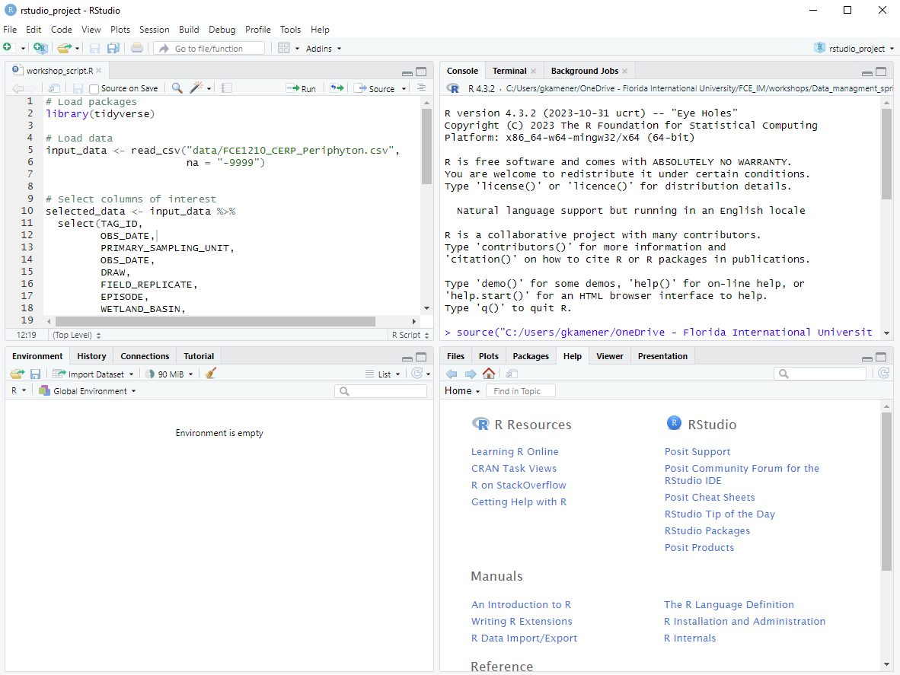
Project Management in RStudio

Slide 19
RStudio Projects
Advantages of RStudio Projects:
Automatically set working directory
Portable
Collaborator friendly
Supports version control with Git/GitHub
Can aid reproducibility with renv package
Can integrate with GitHub Copilot

Slide 20
Setting up an RStudio Project
Start RStudio.
Under the File menu, click on New Project. Choose New Directory, then New Project.
Enter a name for this new folder (or “directory”) and choose a convenient location for it. This will be your working directory.
Click on Create Project.
Create folders for data (with “raw”, “intermediate”, and “final” subfolders), r scripts, and figures in your working directory.
Place raw data files and script files into respective folders.
Adapted from: https://datacarpentry.github.io/R-ecology-lesson/introduction-r-rstudio.html#getting-set-up-in-rstudio

Slide 21
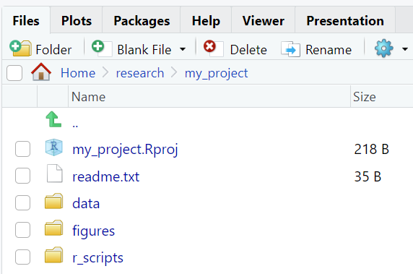
Organizing Your Working Directory

Slide 22
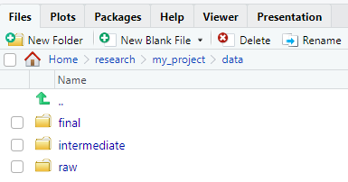
Organizing Your Working Directory

Slide 23


RStudio Projects: Portability
R script without RStudio project:
Often requires specifying working directory or full file path
Script may break if “my_project” folder is moved or shared
With RStudio project:
Path always relative to “my_project” folder
Project becomes portable

Slide 24
GitHub Copilot in RStudio
“Any use of generative ‘AI’ should be transparent, accountable and acknowledged. Check the editorial policies of journals before submission to ensure you are using the most up-to-date guidance” – Cooper et al. 2025
Check with your advisor and institution before using generative AI for anything research related.

Slide 25
GitHub Copilot in RStudio
“You need a fundamental understanding of coding to be able to use Copilot effectively.” – O’Hara and Kui 2025
Following data-management best practices will enable better use of GitHub Copilot

Slide 26
GitHub Copilot in RStudio
GenAI programming resources recently featured in LTER IM monthly meeting
Casey O’Hara and Li Kui (2025), AI for Ecologists. URL https://nceas-learning-hub.github.io/ai_for_nceas.
Elmendorf (2026), NWT LTER AI Tools Introduction. URL https://nwtlter.github.io/data_skills/AI_intro_to_AI.html

Slide 27
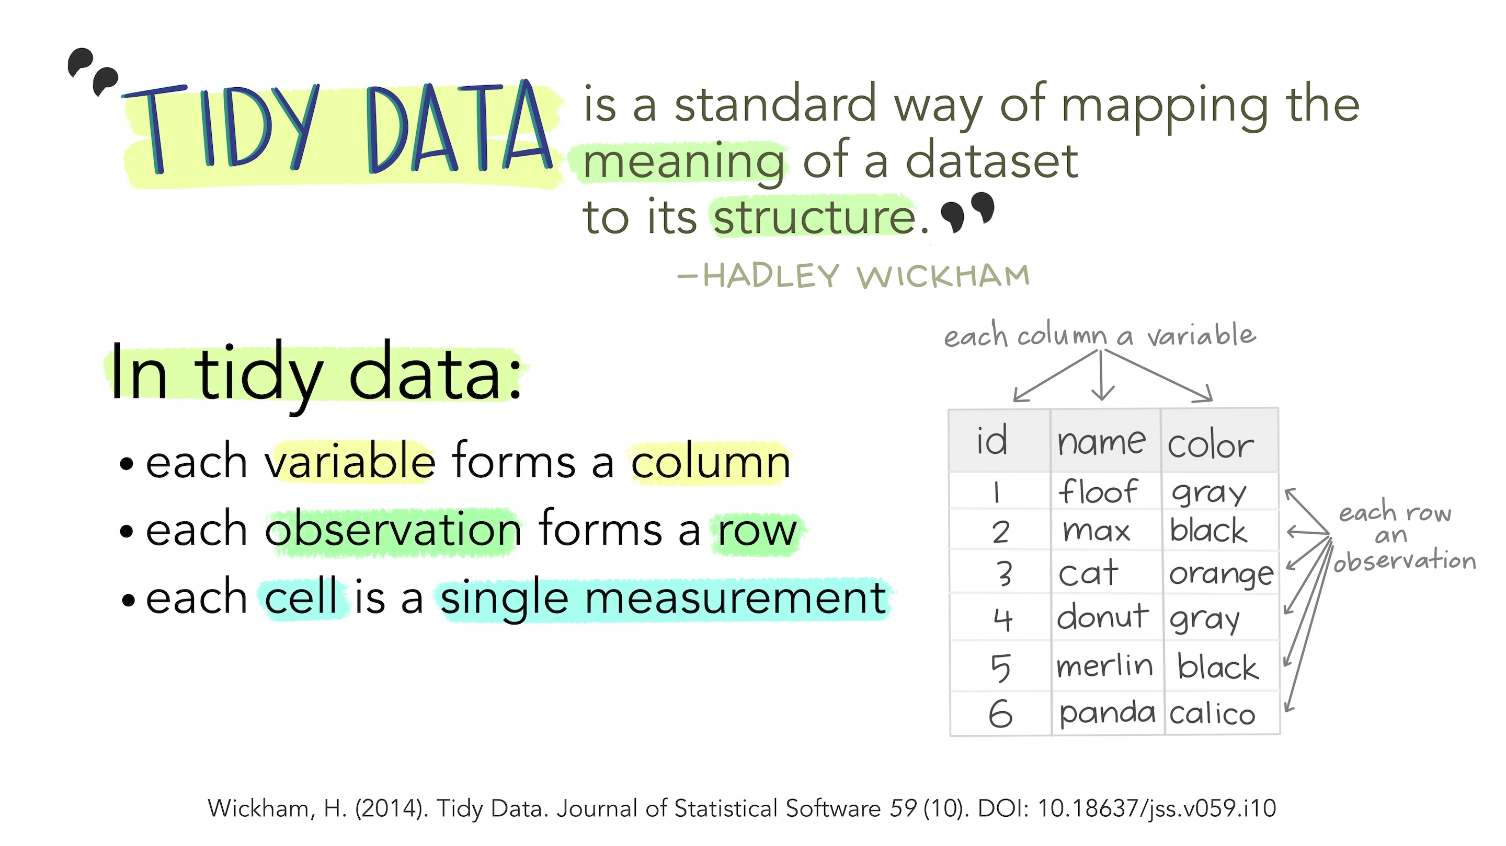
Formatting Data: Tidy is the Goal
Artwork by @allison_horst (CC BY 4.0)

Slide 28
Formatting Data
One rectangle of data
No blank columns or rows
No blank cells
One data type per column
One value per cell
Use simple headers
No spaces
No special characters
Plot # | Subject ID | Weight1207 | Stage1207 | Sex
1 | 1 | 33.2, 1 |  | m
five | 2? Not 100% sure | 44.0 | 2 | F
#1 | 3 |  | three | male
Date | Plot | Subject_ID | Weight | Stage | Sex | Comment
2012-07-01 | 1 | 1 | 33.2 | 1 | m | NA
2012-07-01 | 5 | 2 | 44.0 | 2 | f | Unsure of id
2012-07-01 | 1 | 3 | -9999.0 | 3 | m | Forgot to measure

Slide 29
Formatting Data
Format dates as YYYY-MM-DD
Use consistent categorical variable codes
Avoid calculations or graphs
Plot # | Subject ID | Weight1207 | Stage1207 | Sex
1 | 1 | 33.2, 1 |  | m
five | 2? Not 100% sure | 44.0 | 2 | F
#1 | 3 |  | three | male
Date | Plot | Subject_ID | Weight | Stage | Sex | Comment
2012-07-01 | 1 | 1 | 33.2 | 1 | m | NA
2012-07-01 | 5 | 2 | 44.0 | 2 | f | Unsure of id
2012-07-01 | 1 | 3 | -9999.0 | 3 | m | Forgot to measure

Slide 30
Formatting Data
Don’t highlight cells or embed comments
Document any changes you make
Store metadata in separate sheet or file
Plot # | Subject ID | Weight1207 | Stage1207 | Sex
1 | 1 | 33.2, 1 |  | m
five | 2? Not 100% sure | 44.0 | 2 | F
#1 | 3 |  | three | male
Date | Plot | Subject_ID | Weight | Stage | Sex | Comment
2012-07-01 | 1 | 1 | 33.2 | 1 | m | NA
2012-07-01 | 5 | 2 | 44.0 | 2 | f | Unsure of id
2012-07-01 | 1 | 3 | -9999.0 | 3 | m | Forgot to measure

Slide 31
Metadata
What are metadata?
Metadata = data about data
Document who, what, why, where, and when
Why use metadata?
Keep track of important details about data
Required to publish datasets
Increase findability and usability of published data

Slide 32
Documenting Metadata
Dataset metadata should include:
Data table information (i.e. data dictionary)
Title
Abstract
Parties responsible for dataset
Methods
Intellectual rights
Keywords
Geographic, temporal, and taxonomic coverage
Information about non-tabular data (if applicable)
Project funding
Permits (if applicable)

Slide 33
Documenting Metadata: Data Dictionary
Describes data table variables (Broman and Woo 2018)
Create as early as possible!
Column Name | Definition | Variable Type | Units | Precision | Codes | Date Time Format String | Missing Value Code | Missing Value Code Explanation
SITENAME | Name of site | Categorical |  |  | SRS2 = Shark River Slough 2
Date | Date of sample collection | DateTime |  |  |  | YYYY-MM-DD
Time | Time of sample collection | DateTime |  |  |  | hh:mm | NA | Not recorded
Salinity | Concentration of salinity | Numerical | PSU | 0.1 |  |  | -9999.0 | Not recorded
TN | Concentration of total nitrogen | Numerical | micromolePerLiter | 0.001 |  |  | -9999.000 | Not recorded
TP | Concentration of total phosphorus | Numerical | micromolePerLiter | 0.01 |  |  | -9999.00 | Not recorded
Comment | Field comments | Text |  |  |  |  | NA | Not recorded

Slide 34
Documenting Metadata
Title
Should be descriptive, including what, where, and when
Do not use manuscript title
Abstract
Describe who, what, why, where, and when of dataset in more detail
Do not include results or conclusions from study
Methods
Detail to answer any questions someone might have
Include list of cited references (if applicable)
Intellectual rights
FCE uses CC-BY Creative Commons license

Slide 35
Documenting Metadata
Keywords
Source from LTER Controlled Vocabulary* when possible
Geographic coverage
Coordinates in decimal degrees for publishing
Temporal coverage
Documents when data were collected
Format as YYYY-MM-DD or YYYY
Taxonomic coverage
Important to check spelling of names
*LTER Controlled Vocabulary link: https://vocab.lternet.edu/vocab/vocab/index.php

Slide 36
Documenting Metadata
Information about non-tabular data entities
Includes metadata about model code, geospatial, imagery, or other data entities
Project funding
Information about funding for data collection
Permits
Permits that were required for data collection

Slide 37
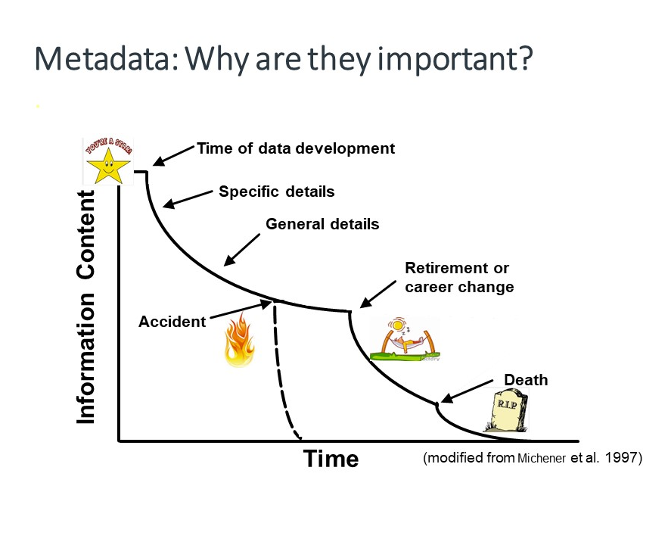
Timing and Importance of Quality Metadata
Important for future you!
Important for discovery and re-use of published data!
LTER Network and EDI use Ecological Metadata Language (EML) to document quality metadata
Image courtesy of DataONE

Slide 38
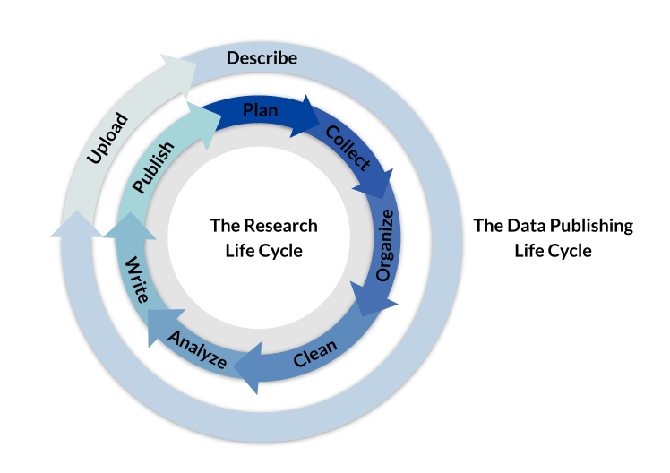
Metadata Creation During Research Life Cycle
Metadata should be described throughout the research life cycle
Describe as much as possible in early stages
Regularly add/update throughout life cycle
Image courtesy of Environmental data Initiative

Slide 39
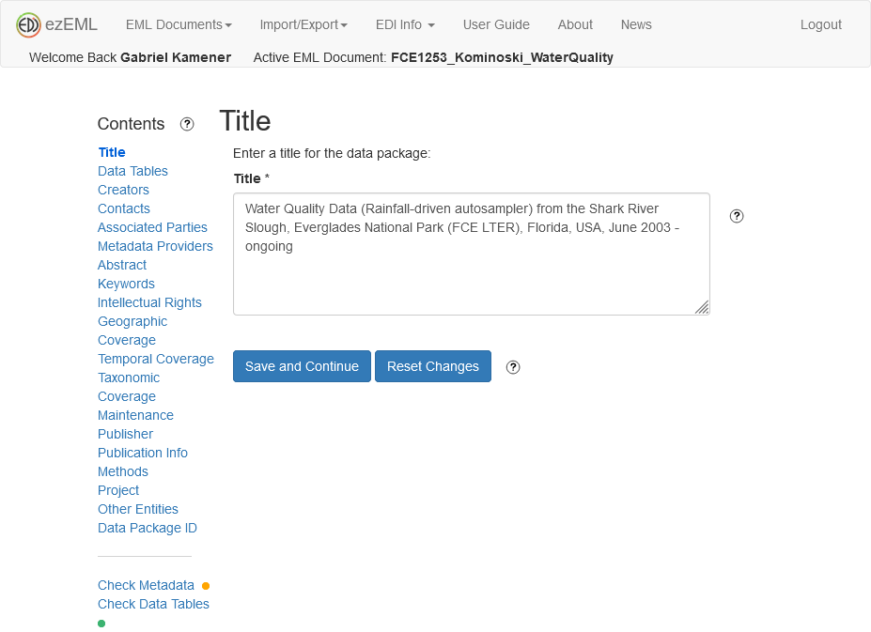
ezEML’s Role in Data Publishing Life Cycle
Form-based web interface to create and edit structured metadata in EML
Can utilize pre-filled FCE templates
Saves as you go
Can quality check data and metadata
Produces data package (data + metadata)
https://ezeml.edirepository.org/eml

Slide 40
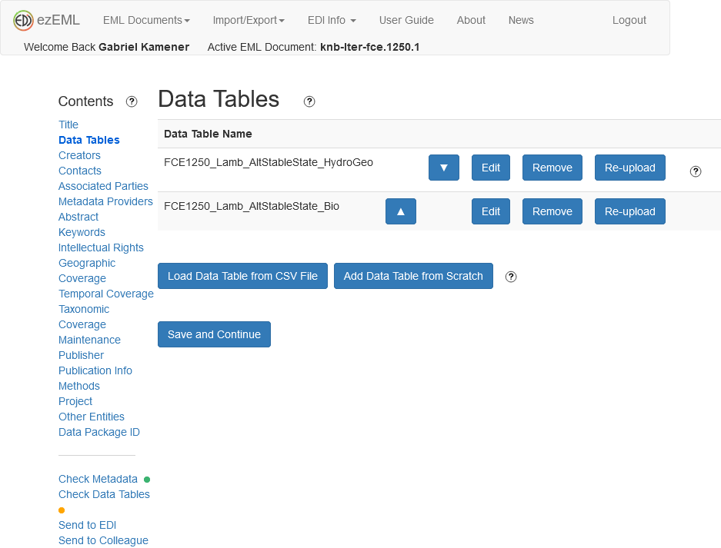
ezEML’s Role in Data Publishing Life Cycle
Can create metadata for tables and other data entities (e.g. model code, imagery, and other nontabular data files)

Slide 41
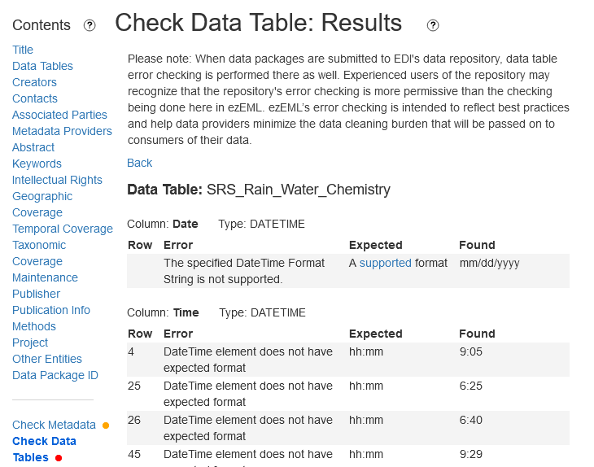
ezEML’s Role in Data Publishing Life Cycle
Quality checks data and metadata
Provides feedback on potential showstoppers (errors) and points to investigate (warnings)

Slide 42
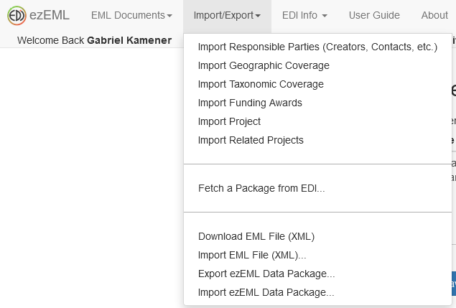
ezEML’s Role in Data Publishing Life Cycle
Can also “fetch” existing packages from EDI to facilitate updates

Slide 43
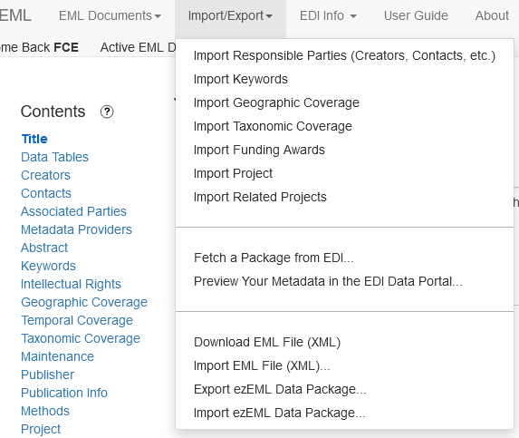
ezEML’s Role in Data Publishing Life Cycle
Preview how your package will look on the EDI Data Portal

Slide 44
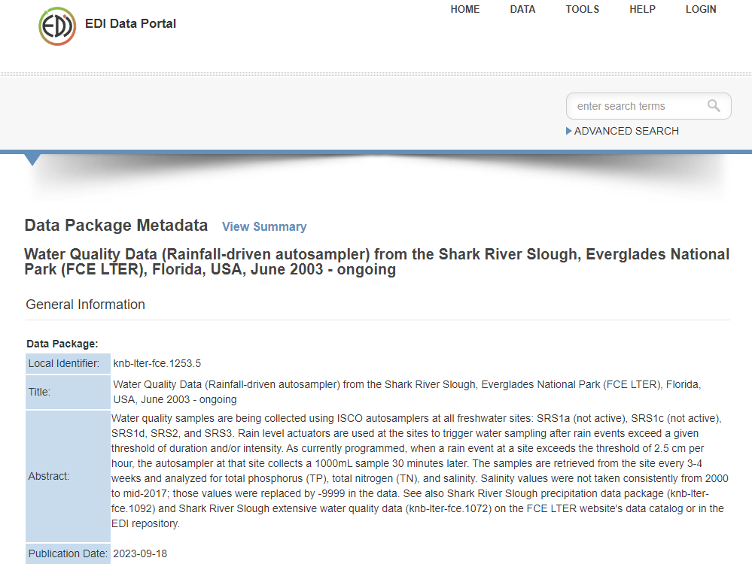
ezEML’s Role in Data Publishing Life Cycle
Preview how your package will look on the EDI Data Portal

Slide 45
Submitting Your Data to the FCE IM
Review the FCE Data page!
Contact the FCE IM to review your data and to receive an FCE dataset ID
Accept ezEML collaboration invite from FCE IM
Enter data and metadata into ezEML
Review with FCE IM
https://fcelter.fiu.edu/data

Slide 46
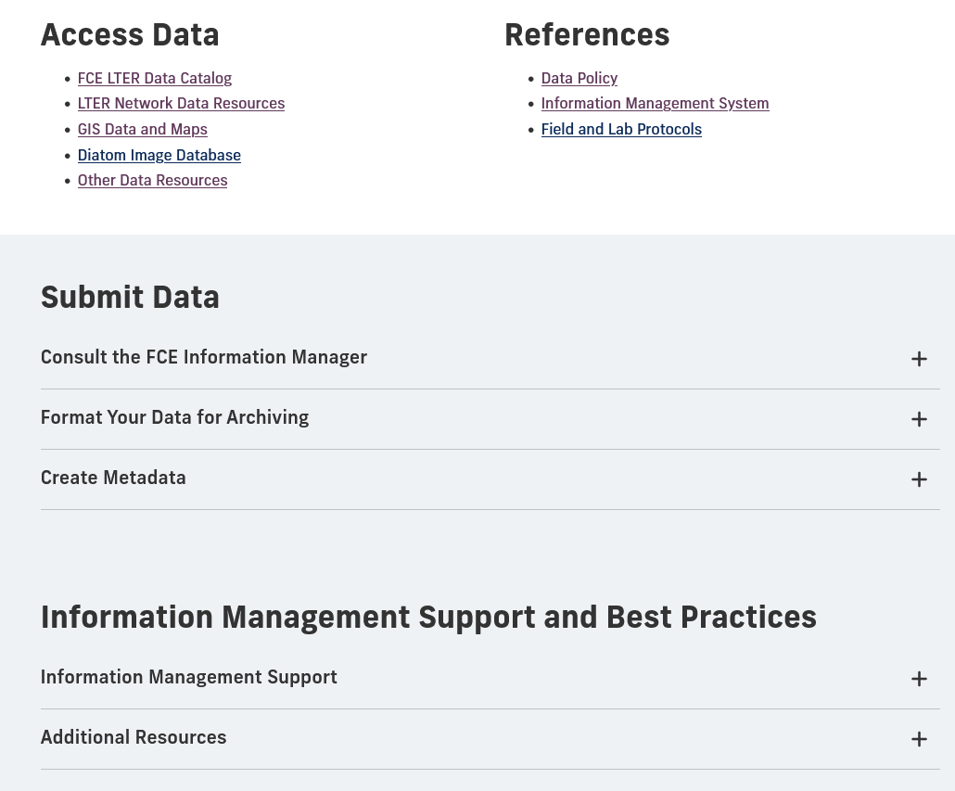
IM Support at FCE
Section on FCE Data page!
Contains IM support information and a growing collection of links to resources on best practices
https://fcelter.fiu.edu/data

Slide 47
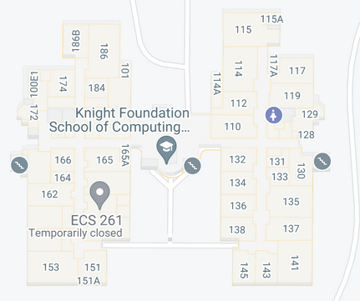
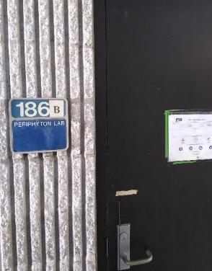
IM Support at FCE
Weekly IM office hours at MMC-CASE 186B, Thursdays 2:00-7:00 pm
IM support at FCE student Think Tank events
Available by email or appointment (in-person or Zoom)

Slide 48
Resources and References
FCE LTER data page - https://fcelter.fiu.edu/data
FCE ezEML instructions (PDF file)
Tips for submitting FCE data and metadata (PDF file)
FCE GitHub repository containing this presentation and example metadata documents: https://github.com/FCE-LTER/intro_to_fce_data_management_and_publication
Briney, K. A., Coates, H. L., & Goben, A. (2020). Foundational practices of research data management. Research Ideas and Outcomes 6: e56508. https://doi.org/10.3897/rio.6.e56508
Briney, K. (2023). The Research Data Management Workbook. Caltech Library. https://doi.org/10.7907/z6czh-7zx60
Broman, K. W., & Woo, K. H. (2018). Data organization in spreadsheets. The American Statistician, 72(1), 2-10. https://doi.org/10.1080/00031305.2017.1375989

Slide 49
Resources and References
Casey O’Hara and Li Kui (2025), AI for Ecologists. https://nceas-learning-hub.github.io/ai_for_nceas.
Cooper, N., Hsing, P.-Y., Almarzouq, B., Baldauf, S., Chatterjee, N., Plomp, E., Strydom, T., Takola, E., & Zagrodzka, Z. (2025). Guide to Reproducible Code (v2.0.1). Zenodo. https://doi.org/10.5281/zenodo.17855982
Data Carpentry course episode: Introduction to R and RStudio
Elmendorf (2026), NWT LTER AI Tools Introduction. https://nwtlter.github.io/data_skills/AI_intro_to_AI.html

Slide 50
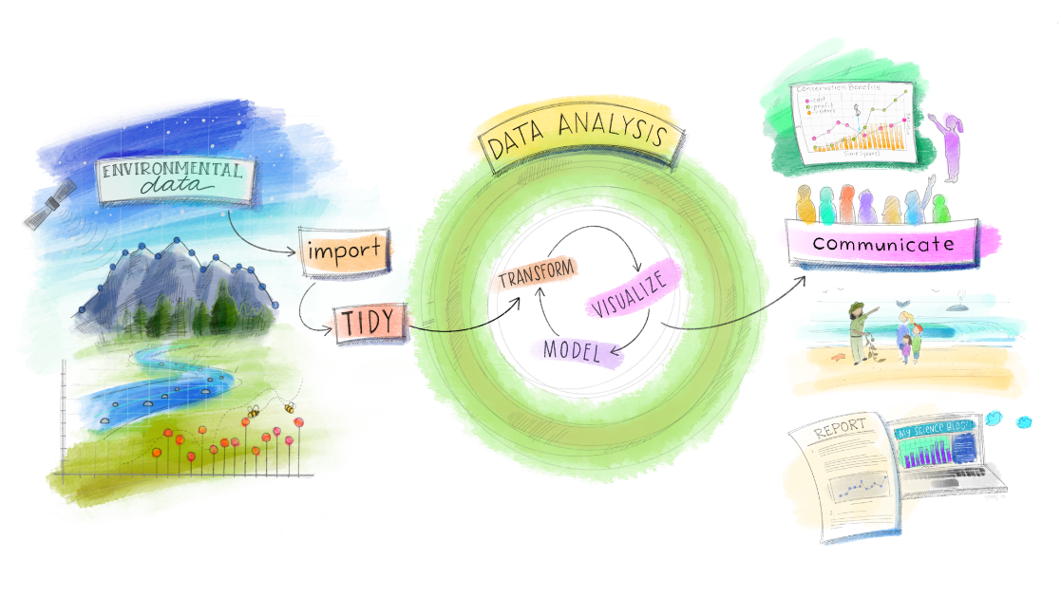
Questions and Discussion
Credit: Artwork from @juliesquid for @openscapes (illustrated by @allison_horst).
https://github.com/allisonhorst/stats-illustrations/tree/master/openscapes?fbclid=IwAR0M_Bksd0Hr5IL4Jla7l8m1azBojU8acN5OmZ4QIGv20xcVbBhbkvpGbIw

